Slide 1
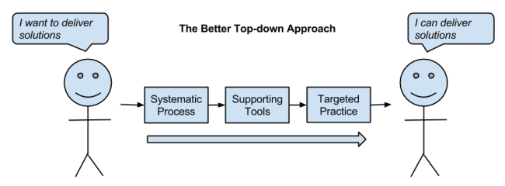
Machine Learning University 101
Michael Gong

Slide 2
Course Goal
This course is geared toward colleagues have no experience in applied machine learning. Our goal is to introduce the systematic machine learning process and several of the most popular and powerful libraries for building machine learning project in Python. That means we'll brush over much of the theory and math.

Slide 3
Agenda
Machine Learning Introduction (June 6, PM)
Systemic machine learning process (June 6, PM)
Unsupervised Learning (June 6-7)
Supervised Learning (June 7)
Contest (June 8)

Slide 4
Machine Learning Introduction

Slide 5
Agenda
What is machine learning?
Machine Learning vs Deep Learning vs AI
Why Machine Learning now?
How to Learn Machine Learning ?

Slide 6
A Friendly Introduction to Machine Learning
A Friendly Introduction to Machine Learning.mp4

Slide 7
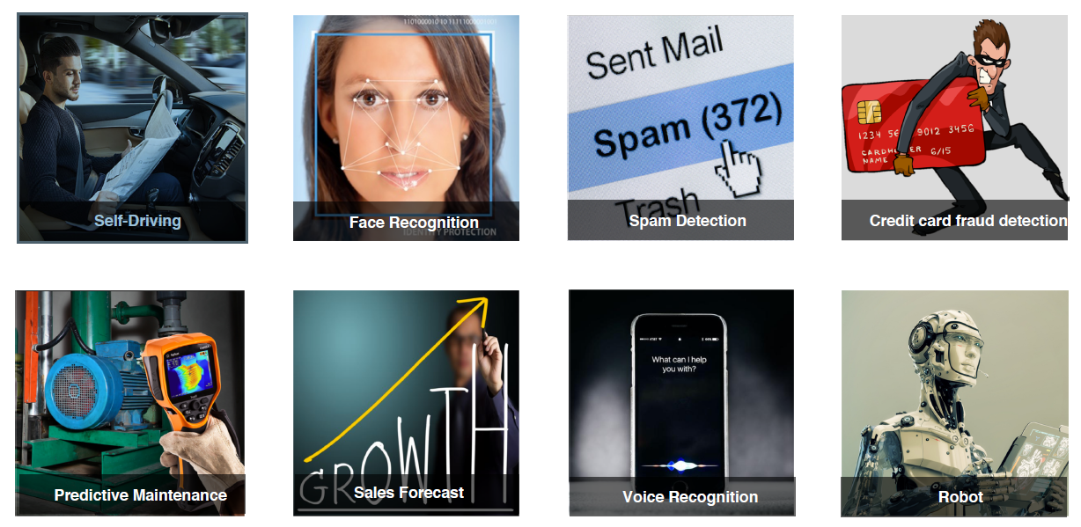
Machine Learning – all around us

Slide 8
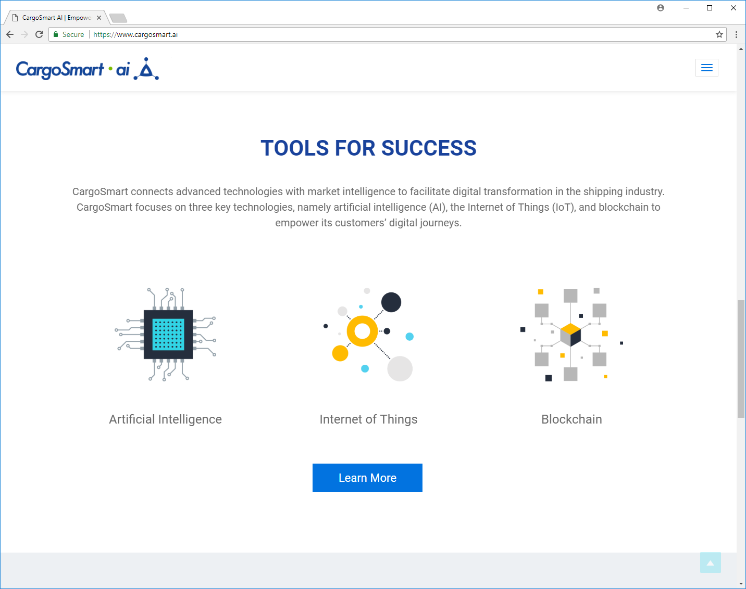
Machine Learning – in OOCL

Slide 9
Machine Learning Use Case

Slide 10
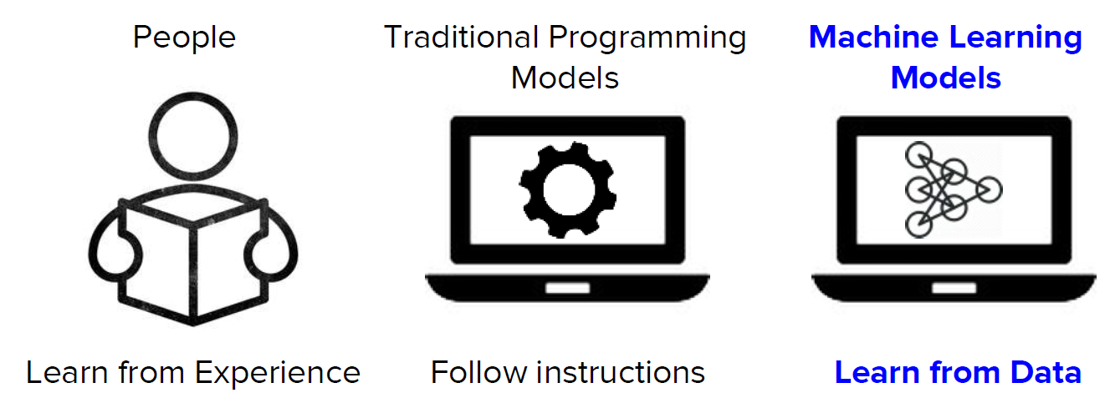
What is Machine Learning?

Slide 11
What is Machine Learning?
A computer program is said to learn from experience E with respect to some task T and some performance measure P, if its performance on T, as measured by P, improves with experience E.
- 1997, Tom Mitchell
Data
Experience E
Machine Learning System
Skills
Improvement at task T measure by P

Slide 12
What is Machine Learning?
A computer program is said to learn from experience E with respect to some task T and some performance measure P, if its performance on T, as measured by P, improves with experience E.
- 1997, Tom Mitchell
Machine Learning is the science of getting
computers to act without being
explicitly programmed.
- Andrew Ng (吴恩达)
Machine learning is a technique of data science that helps computers learn from existing data in order to forecast future behaviors, outcomes, and trends.
- Microsoft

Slide 13
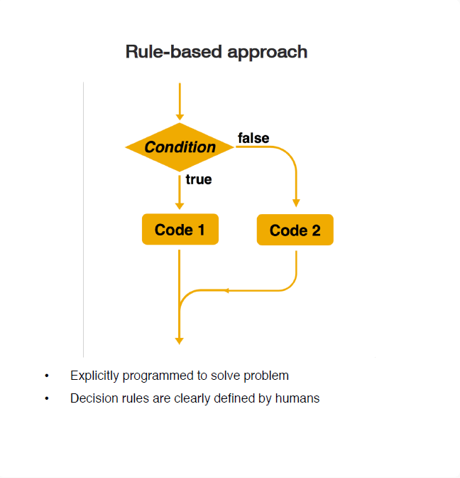
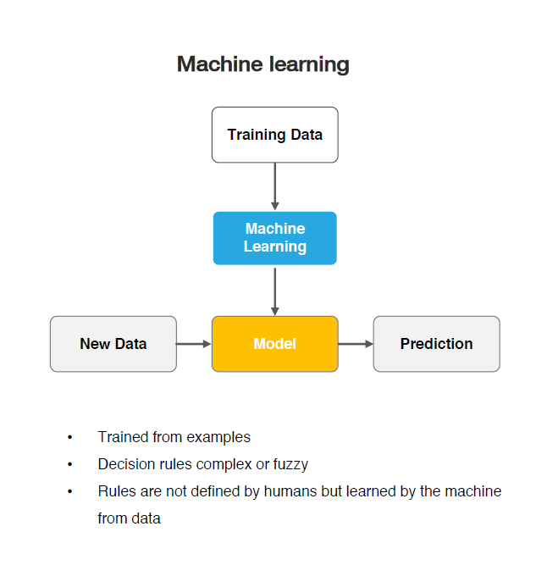
Rule-based vs Machine Learning

Slide 14
The model performance
with future data

Slide 15
Types of machine learning problems
Supervised
Unsupervised
Reinforcement
Learning from labeled data
E.g., Spam classification
Discover structure in unlabeled data
E.g., Document clustering
Learning by “doing” with delayed reward
E.g., Chess computer

Slide 16
Machine Learning vs Deep Learning vs AI
Human intelligence exhibited by machines.
The systems implemented today are a form of narrow AI – a system that can do just one (or a few) defined things as well or better than humans.
Artificial Intelligence
An approach to achieve artificial intelligence through systems that can learn from experience to find patterns in a set of data
Machine Learning
Deep Learning
A technique for implementing machine learning

Slide 17
Why Machine Learning Hot Now
Availability of data: Earlier, such huge amounts of digital data was not generated because the use of computers for so many purposed was not wide spread. In fact around 90% of the data has been created in the last two years alone.
Availability of powerful hardware: Training different neural networks, even on a GPU sometimes takes weeks. The earlier resources that we had were not powerful enough to train machine learning models. According to Shane Legg, a cofounder of Google DeepMind, a training run that takes one day on a single TPU device would have taken a quarter of a million years on an 80486 from 1990.

Slide 18
How Do I Get Started In Machine Learning?

Slide 19
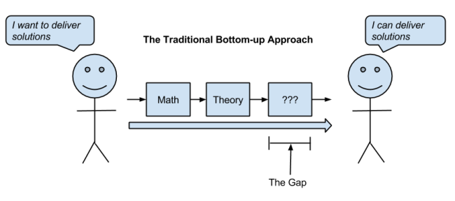
How Do I Get Started In Machine Learning?

Slide 20
How Do I Get Started In Machine Learning?

Slide 21
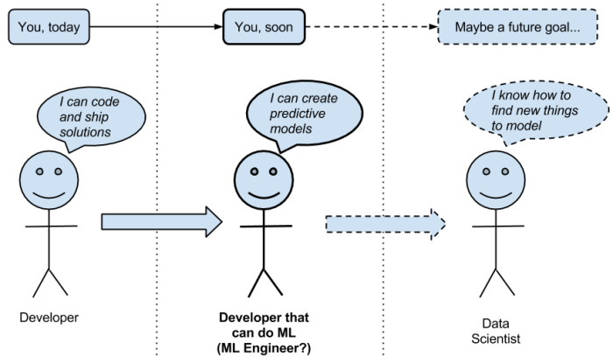
How Do I Get Started In Machine Learning?

Slide 22
Contest Project – Inland ETA Prediction

Slide 23
In-Land ETA Prediction
MT Return Depot
Customer Site
Do Prediction @ this point
Arrival Time?
Laden Pickup Facility
15KM

Slide 24
In-Land ETA Prediction
sample id: shipment_num, cntr_num
shipment info:
bkg_cus_segment
curr_cntr_type, cgo_nature
rf_temp_mag, rf_temp_unit
gross_wt_kg, latest_wt_kg
ib_haulage
brief_desc, majority_code_2d
transit_hours_o2c
dest_fcil_cde
dest_enter_time
dest_lat
dest_lon
MT Return Depot
cs_enter_time
cs_exit_time
cs_lat
cs_lon
Customer Site
Do Prediction Here
Arrival Time?
Laden Pickup Facility
shipment_num, cntr_num
event_time, lat, lon,
power_status
temper_sa
temper_ra
temper_am
15KM
gps_orig_time gps_orig_lat gps_orig_lon google_distance_km google_duration_hour
orig_fcil_cde, orig_exit_time, orig_lat, orig_lon

Slide 25
Systemic machine learning process

Slide 27
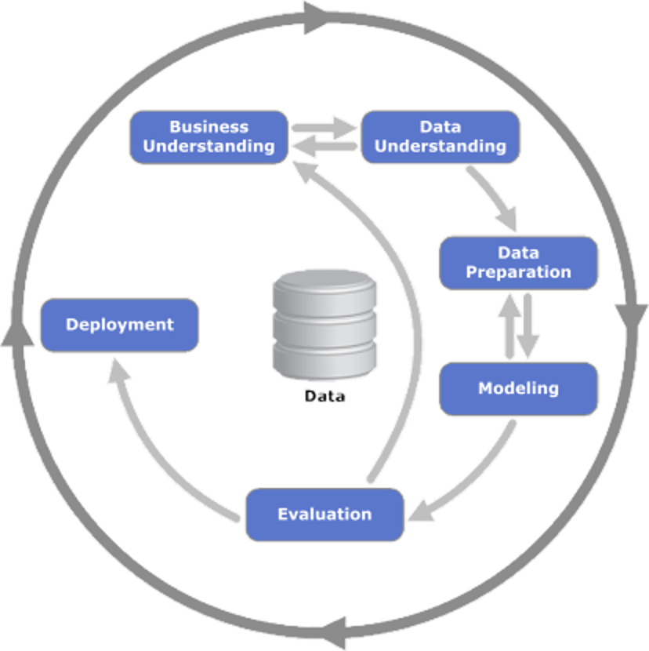
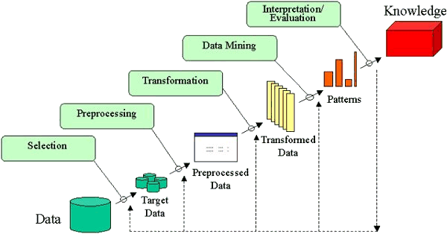
Cross-Industry Standard Process for Data Mining
(CRISP-DM)
Knowledge Discovery in Databases
(KDD)

Slide 28
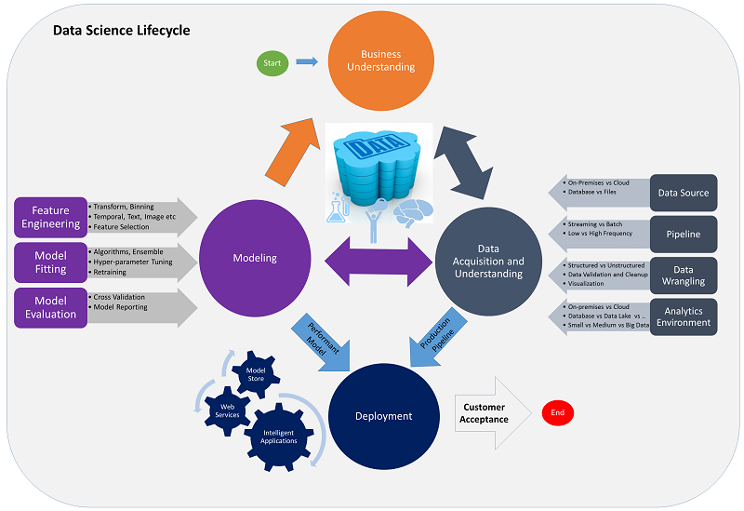
Team Data Science Process
Business Understanding
Data Understanding
Data Preparation
Modeling
Evaluation
Deployment
https://docs.microsoft.com/en-us/azure/machine-learning/team-data-science-process/

Slide 29
Business Understanding
Goals
Specify the key variables that are to serve as the model targets and whose related metrics are used determine the success of the project.
Identify the relevant data sources that the business has access to or needs to obtain.
How to do it
Define objectives: Work with your customer and other stakeholders to understand and identify the business problems. Formulate questions that define the business goals that the data science techniques can target.
Identify data sources: Find the relevant data that helps you answer the questions that define the objectives of the project.

Slide 30
Business Understanding
Do you need machine learning?
Can you formulate your problem clearly?
Do you have sufficient examples?
Does your problem have a regular pattern?
Can you find meaningful representations of your data?
How do you define success?
Frame the Machine Learning Problem

Slide 31
Business Understanding - Example
Do you need machine learning?
High manual effort to monitor store shelves every day
Detecting products in images not possible with simple rules
Can you formulate your problem clearly?
Given a shelf image, first detect products and then compare their positions with the planned shelf
layout
Input: photo; output: bounding boxes of products
Do you have sufficient examples?
Large volume of collected retail shelf pictures, manually labelled bounding boxes of products
Does your problem have a regular pattern?
Product packaging has regular shape, colors, and logos
Can you find meaningful representations of your data?
Represent photos as array of pixel values
Image patches with products are positive examples; random patches are negative examples
How do you define success?
Measure precision and recall of predicted bounding boxes and similarity of the detected layout to the true layout

Slide 32
When should you use machine learning ?

Slide 33
Data Understanding
Goals
Produce a clean, high-quality data set whose relationship to the target variables is understood. Locate the data set in the appropriate analytics environment so you are ready to model.
Develop a solution architecture of the data pipeline that refreshes and scores the data regularly.
How to do it
Ingest the data into the target analytic environment.
Explore the data to determine if the data quality is adequate to answer the question.
Set up a data pipeline to score new or regularly refreshed data.

Slide 34
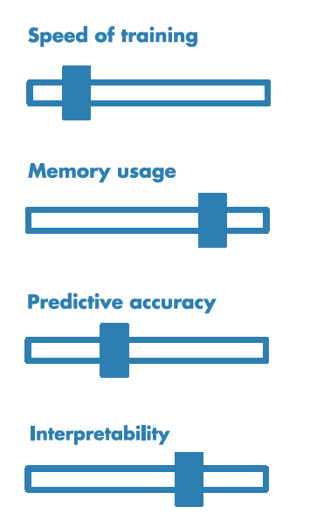
Modeling
Goals
Determine the optimal data features for the machine-learning model.
Create an informative machine-learning model that predicts the target most accurately.
Create a machine-learning model that's suitable for production.
How to do it
There are three main tasks addressed in this stage:
Feature engineering: Create data features from the raw data to facilitate model training.
Model training: Find the model that answers the question most accurately by comparing their success metrics.
Determine if your model is suitable for production.

Slide 35
Deployment
Goal
Deploy models with a data pipeline to a production or production-like environment for final user acceptance.
How to do it
The main task addressed in this stage:
Operationalize the model: Deploy the model and pipeline to a production or production-like environment for application consumption.
Operationalize the model:
Online websites
Spreadsheets
Dashboards
Line-of-business applications
Back-end applications
Notes:
After you have a set of models that perform well, you can operationalize them for other applications to consume. Depending on the business requirements, predictions are made either in real time or on a batch basis. To deploy models, you expose them with an open API interface. The interface enables the model to be easily consumed from various applications, such as:

Slide 36
“Machine Learning” Process
Business KPI
1 Refine Target/Metric
2 Extract Derived Features
5 Evaluate Model
3 Select Features
4 Fit Model

Slide 37
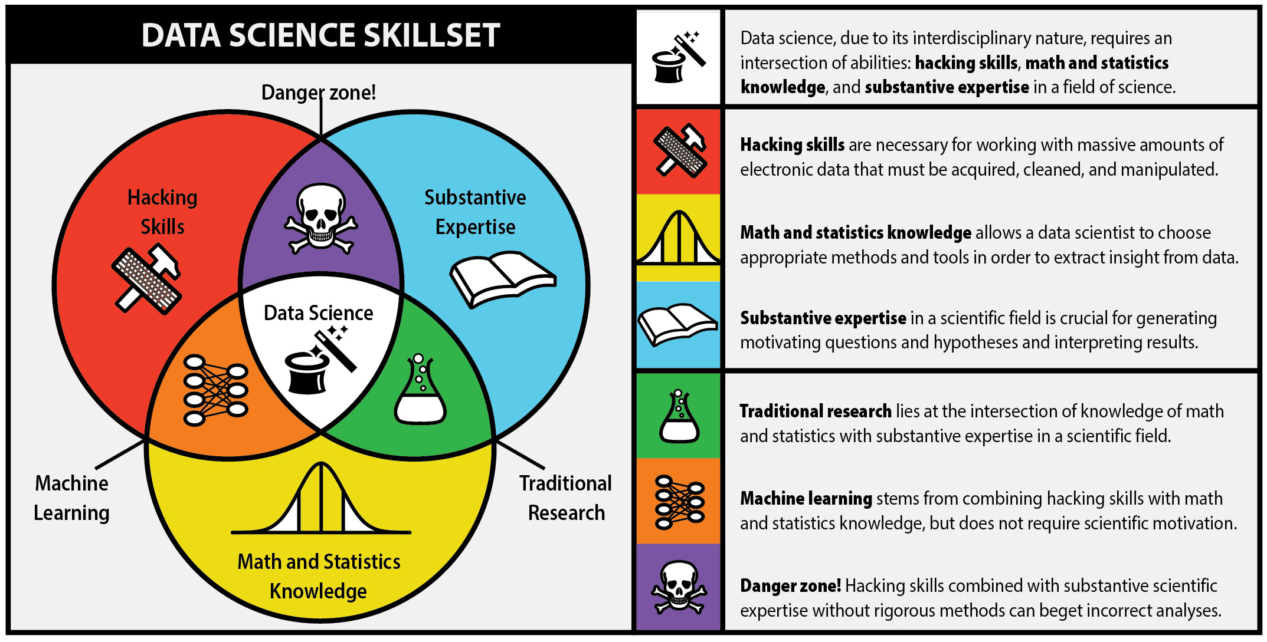
Data Science Skillset

Slide 38
Supervised & Unsupervised

Slide 39
Unsupervised Learning
Clustering
Dimension reduction
Reinforcement Learning
Learn from simulated data generated by agent-environment interaction
Learn by trial-and-error through reward and punishment
Email intent recognition
Word2Vec
Learn from labeled data
Learn from unlabeled data
Classification
Email intent classification
Booking cancellation prediction
Regression
MT release/return forecast
Vessel utilization forecast
Dynamic ETA
Sequential decision
Commodity
Supervised Learning

Slide 40
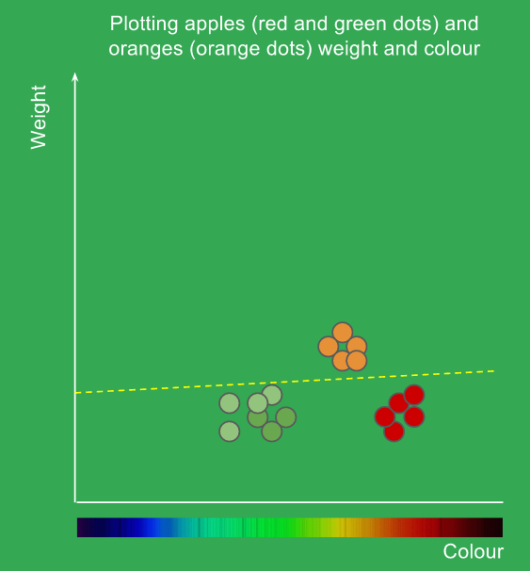
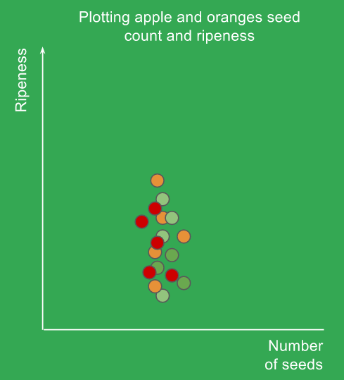
Supervised learning system
Task: to classify orange and apple
Watermelon
Feature
Label
ID | Color | Weight | Label
1 | Red | 260 | Apple
2 | Red | 240 | Apple
3 | Orange | 340 | Orange
4 | Green | 220 | Apple
5 | Green | 200 | Apple
… | … | … | …
m | Orange | 380 | Orange

Slide 41
Supervised learning system
Learn from labeled data
Trained model can be used to do prediction
Cannot predict stuff that it does not know about

Slide 42
Unsupervised learning system
Feature
ID | Color | Weight
1 | Red | 260
2 | Red | 240
3 | Orange | 340
4 | Green | 220
5 | Green | 200
… | … | …
m | Orange | 380

Slide 43
Un-supervised learning system
Learn from unlabeled data
Used to find some intrinsic pattern of data but no prediction
Manual effort required to interpret meaning of the clustering result
Can be used as a feature of supervised learning system

Slide 44
Supervised: All data is labeled and the algorithms learn to predict the output from the input data.
Unsupervised: All data is unlabeled and the algorithms learn to inherent structure from the input data.
Semi-supervised: Some data is labeled but most of it is unlabeled and a mixture of supervised and unsupervised techniques can be used.

Slide 45
Supporting Tools
Python
Pandas / Numpy
Scikit-Learn

Slide 46
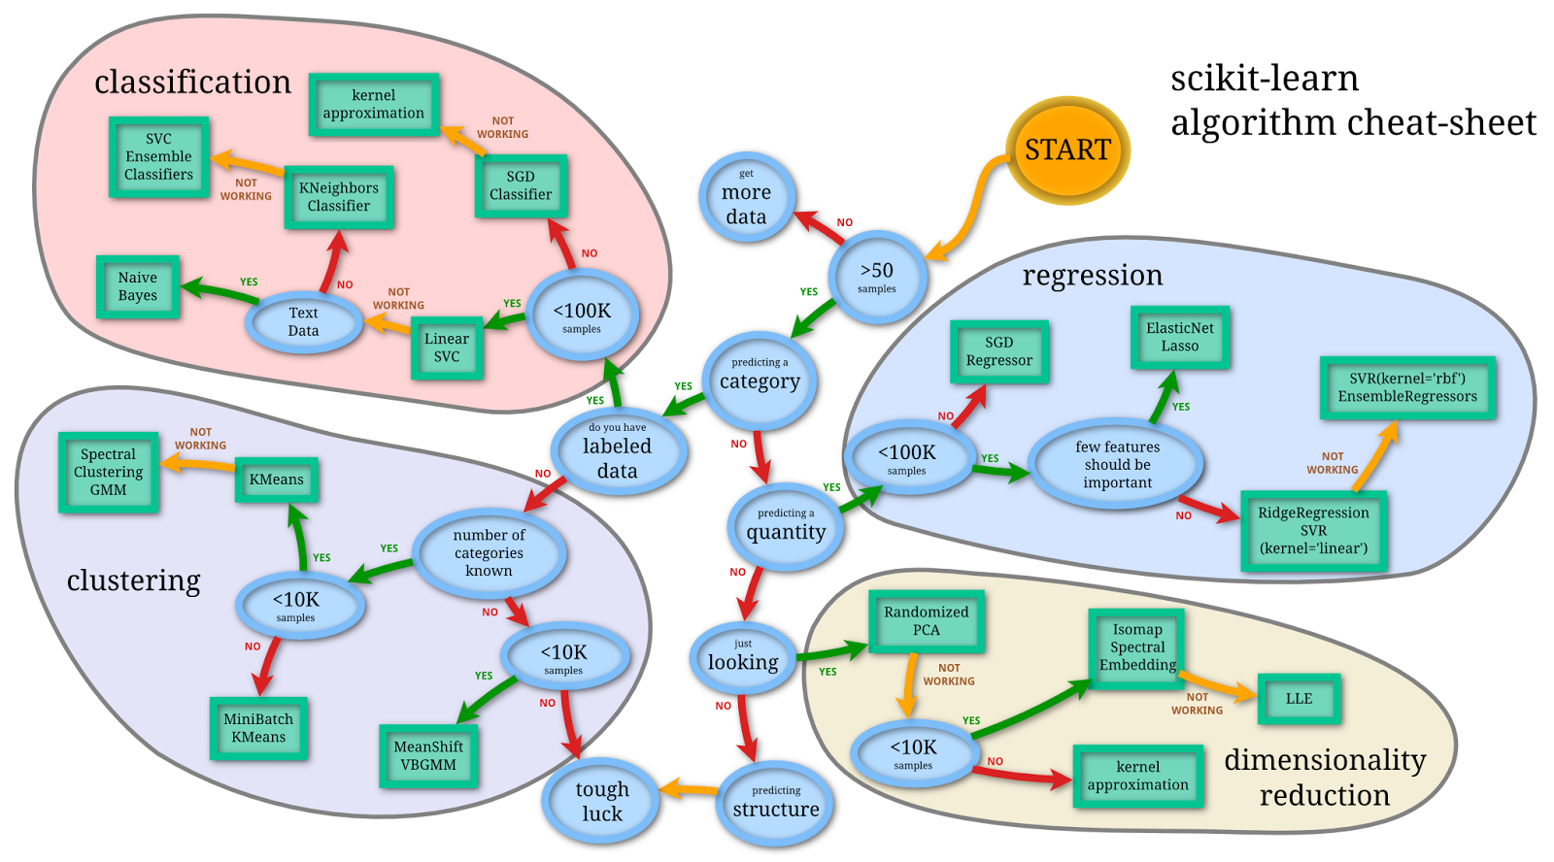
Scikit-learn

Slide 47
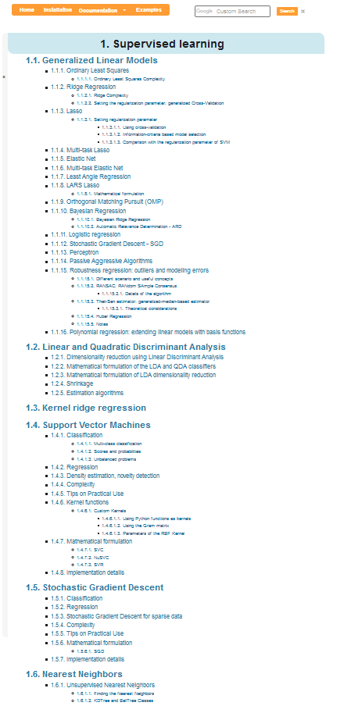
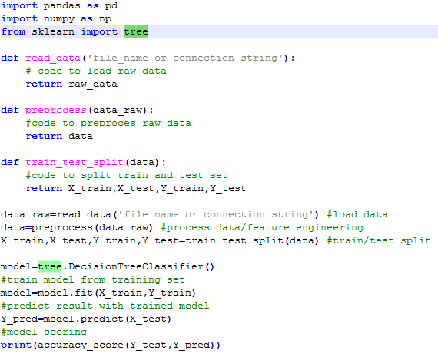
Supervised learning with python scikit-learn
1. New a model
2. Fit the model
3. Do prediction
4. Evaluate the model
That’s it!
http://scikit-learn.org/stable/supervised_learning.html

Slide 48
Unsupervised learning system

Slide 49
Un-supervised learning system
Learn from unlabeled data
Used to find some intrinsic pattern of data but no prediction
Manual effort required to interpret meaning of the clustering result
Can be used as a feature of supervised learning system

Slide 50
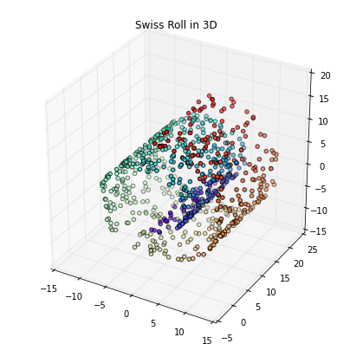
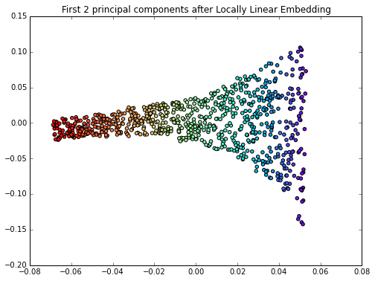
Unsupervised Learning
Unsupervised
Clustering
Compression

Slide 51
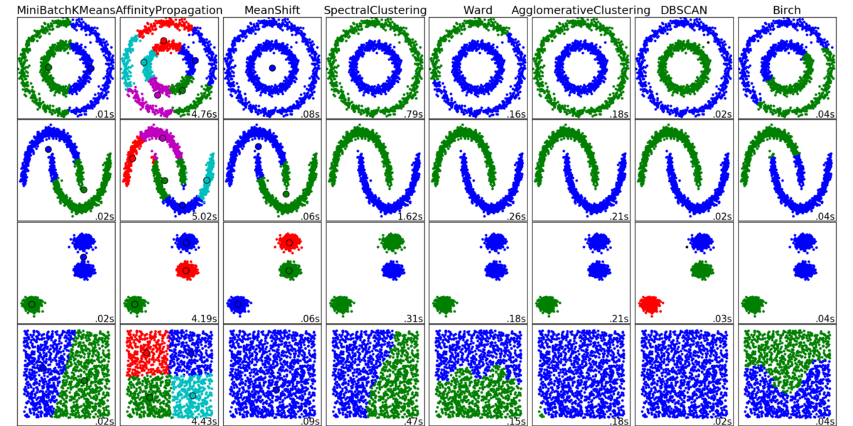
Algorithms

Slide 52
Unsupervised learning: Unsupervised Transformers
transformer.fit(X_train)
X_train = transformer.transform(X_train)
X_test = transformer.transform(X_test)

Slide 53
Example 1 – k-mean

Slide 54
Example 2 - PCA

Slide 55
Example 3 - DBSCAN

Slide 56
Supervised learning system
Learn from labeled data
Trained model can be used to do prediction
Cannot predict stuff that it does not know about

Slide 57
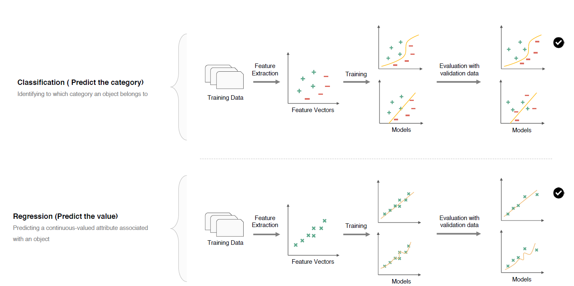
Supervised Learning

Slide 58
Learning = Representation + Evaluation + Optimization
Representation: A classifier must be represented in some formal language that the computer can handle. Conversely, choosing a representation for a learner is tantamount to choosing the set of classifiers that it can possibly learn. This set is called the hypothesis space of the learner. If a classifier is not in the hypothesis space, it cannot be learned. A related question is how to represent the input, i.e., what features to use.
Evaluation: An evaluation function is needed to distinguish good classifiers from bad ones. The evaluation function used internally by the algorithm may differ from the external one that we want the classifier to optimize, for ease of optimization and due to the issues discussed in the next section.
Optimization: Finally, we need a method to search among the classifiers in the language for the highest-scoring one. The choice of optimization technique is key to the efficiency of the learner, and also helps determine the classifier produced if the evaluation function has more than one optimum. It is common for new learners to start out using off-the-shelf optimizers, which are later replaced by custom-designed ones.

